Slide 1
Milestone 1
May 10
Milestone 4
Milestone 2
Aug 12
May 15
Milestone 3
Milestone 5
Milestone 7
Jul 21
Nov 7
Milestone 6
Jan 30
Dec 20
2015
May
Jun
Jul
Aug
Sep
Oct
Nov
Dec
2016
2016
5 days
Today
Task 1 Here
Jul 25 - Aug 1
16 days
Task 2 Here
Aug 15 - Sep 7
24 days
Task 3 Here
Aug 15 - Sep 17
17 days
Task 4 Here
Sep 8 - Sep 30
25 days
Task 5 Here
Oct 4 - Nov 7

Slide 2
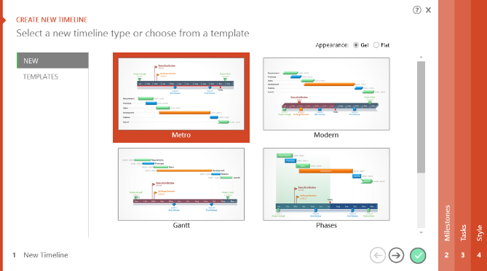

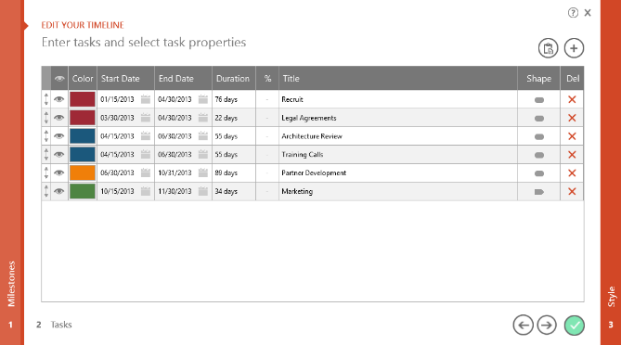
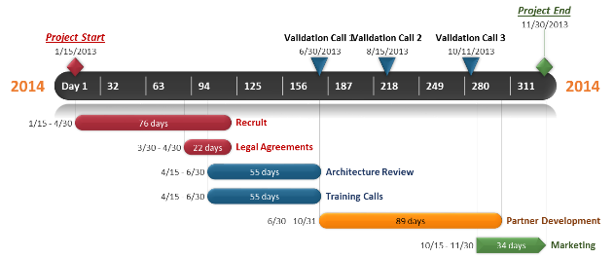
To change and update this template automatically,
download the free Office Timeline PowerPoint add-in!
Office Timeline is a free, award winning, timeline maker that's really easy to use.
Simple, easy-to-use wizards.
Professional, quick results.
Built directly into PowerPoint

